Slide 1

WISEMAN QA – TRAINING TRACK

Slide 2
Team Structure
Name | Title | Team Allocation
Farrukh Shahzad Ahmed | SQA Team Lead | ACO Implementation, 360 DL, 360 CM
Mohsin Ali | Sr. SQA Engineer | ACO Implementation, 360 DL, 360 Data Team, 360 CM
Haroon Khan | Sr. SQA Engineer | 360 Data Team (Primary), 360 DL (Secondary)
Adeelah Qureshi | SQA Engineer | 360 CM (Primary), ACO Implementation CM (Primary)
Jawad Basheer | SQA Engineer | 360 CM (Primary), ACO Implementation CM (Primary)
Sana Ilyas | SQA Engineer | 360 POC (Primary), 360 DL (Secondary)
Syed Abdul Mughees | SQA Engineer | 360 Patient Touch (Primary), 360 CM (Secondary), 360 Capture (Primary)
Nadeem Ahmad | SQA Engineer | 360 Data (Primary), 360 DL (Secondary)
Asma Naeem | SQA Engineer | 360 DL (Primary), 360 Data Team (Secondary)

Slide 3
QA Team Structure Product-Wise
  360 QA
    360 DeepLearn
    360 CareManager
    ACO Implementation
    360 POC
    360 Monthly Data
    360 Capture
    360 Patient Touch

Slide 4
Common Challenges at Organization
Communication gaps
Definition of Done approach from Dev Teams
Lack of Dev and QA teams Holistic Development
Iterative or redundant activities in terms of smoke tests being manual
Effort estimates often consumed by dev teams more than what’s left for QA to test
Performance issues of 360 Applications

Slide 5
Possible Control Metrics to cater challenges
Communication Gaps
A comprehensive and clear definition of Sprint Backlog Items and Sprint Release items should be known to QA well before time of UAT
Any surprise or known bugs identified by Dev person either resolved, or should be clearly briefed to QA with its impacts over Ongoing item to be tested
Definition of Done approach from Dev Teams:
Developers are to be responsible for at least perform a Unit Test to cater any surprises or warnings, before QA initiates testing and report back during smoke or early testing.
Internal measurement practice should be the delivery of application with 0 known bugs.

Slide 6
Possible Control Metrics to cater challenges
Lack of Dev and QA teams Holistic Development
Acceptance Criteria or any design mock ups needs to be clearly provided that both Dev n QA collectively understand to deliver what’s expected.
Any change in ongoing development needs to be put on table for team to digest the impacts.
Iterative or redundant activities in terms of smoke tests being manual
Generic Automation Test Scripts to execute Smoke Test Activities. (Plan described in Testing Processes slide)
Automation Test Scripts of Functional Areas that are not taking continuous changes/enhancements.
Automation Test Scripts of Regression Testing of All ACOs.

Slide 7
Possible Control Metrics to cater challenges
Effort estimates often consumed by dev teams more than what’s left for QA to test:
Ideal approach should be of to receive in time, in case not able to receive complete testable item, QA person would be working with Dev as part of Extreme Testing approach to provide feedback well before time in case any requirement or recommendation can be suggested
Re-estimation would be required if Dev consumes more than estimated to cover maximum testing
Performance issues of 360 Applications
Weekly Performance Stats and Modules will be shared to improve performance
Apache Jmeter and Blazemeter will be used
Note: The mentioned challenges and possible metrics may vary in situations.

Slide 8
Testing Processes
Salient features of Testing Process
Automated testing
  360DeepLearn (Automated Smoke Test activity of All ACOs to reduce labor work using Selenium Webdriver Java/C#)
  360 CM (Automated Smoke Test activity of All ACOs to reduce labor work using Selenium Webdriver Java/C#)
  360 Capture (Automated Smoke Test activity of All ACOs to reduce labor work using Selenium Webdriver Java/C#)
  360 Patient Touch (Automated API Testing using Postman API Tool
  360 POC (Automated Smoke Test activity of All ACOs to reduce labor work using Selenium Webdriver Java/C#)
Check list
  Monthly/Quarterly data updates
    Automated and Excel output generated for analysis
  ACO Implementation
Peer Review
Triage Meetings
Sign-off

Slide 9
Testing Process
Story
Functional/Non-Functional testing
Smoke
Bug Fixing
Regression testing
Peer-Review
Story Close

Slide 10
Testing Tools
    Microsoft Test Manager (MTM)
    Team foundation Server (TFS)
    Selenium Web Driver (With C# and Java)
    Microsoft Visual Studio
    Test NG, Maven Build Management Tool
    Apache Jmeter
    Blazemeter
    Postman API Testing and Automation Tool

Slide 11
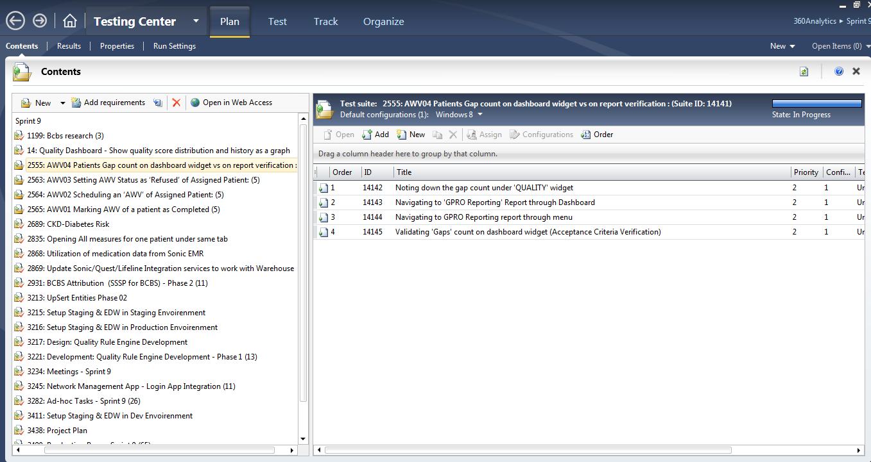
Test Case Template in MTM

Slide 12
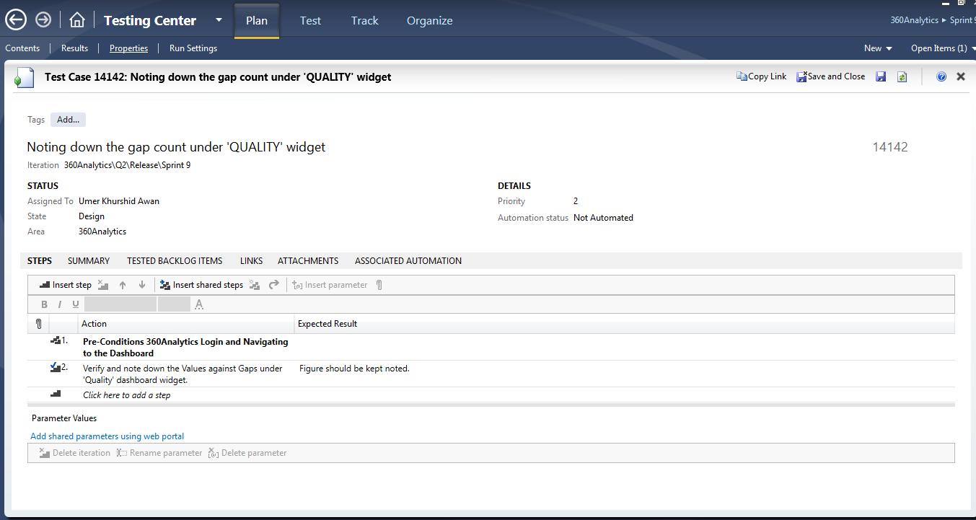
Test Case Template in MTM

Slide 13
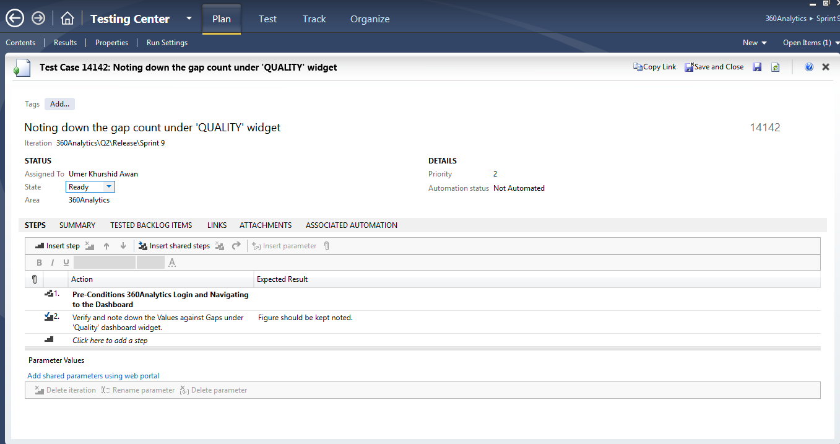
Test Case Template in MTM

Slide 14
Test Automation Tools
We use following tools and technologies for Test Automation:
  Selenium Web driver
  Programming Languages: Java and C# (Separately, depending upon the test cases)
  Testing Framework: TestNG
  Build Tool: Maven

Slide 15
Test Automation Script
    Automation scripts are designed ONLY for the Demo purpose details are:
    360 CC Manager (Application)
      Onboarding (Test case 1) “Java/ TestNG”
      Enrollment (Test case 2) “Java/ TestNG”
      Un-enrollment (Test case 3) “Java/ TestNG”
    360 DeepLearn (Application)
      Schedule Visit (Test case 1) “Java/ TestNG”
      Refuse Visit (Test case 2) “Java/ TestNG”
      Complete Visit (Test case 3) “Java/ TestNG”
      Remove Visit (Test case 4) “Java/ TestNG”
      Fill Measure (Test case 5) “Java/ TestNG”
      Navigate all Clickable links/Export to Excel of All ACOs (Test Case 6) “ Java/TestNG”

Slide 16
Testing Artifacts
    Test Plan
    Test summary Report
    Signoff Document
    Bug life cycle
    WMI UI Form Checklist
    Issues Investigation Report
    Checklist (Smoke, Sanity etc.)
    360 CareManager Use Case Document
    360 DeeLearn Use Case Document
    360 POC Use Case Document
    360 Capture Use Case Document
    360 Patient Touch Use Case Document

